Slide 1
Event Handling
How to make your page respond to the user
Notes:
Justice League chapter

Slide 2
What is an event?
Mouse | Key | Form | Field | Window
click | keydown | change | blur | load
dblclick | keyup | submit | focus | unload
mouseover | keypress | reset | change | resize
mouseout |  |  |  | error
mousedown |  |  |  | scroll
mouseup
mousemove
Notes:
Not a comprehensive list

Slide 3
unload vs beforeunload
beforeunload happens ... well ... before unload
beforeunload is cancelable. unload is not.

Slide 4
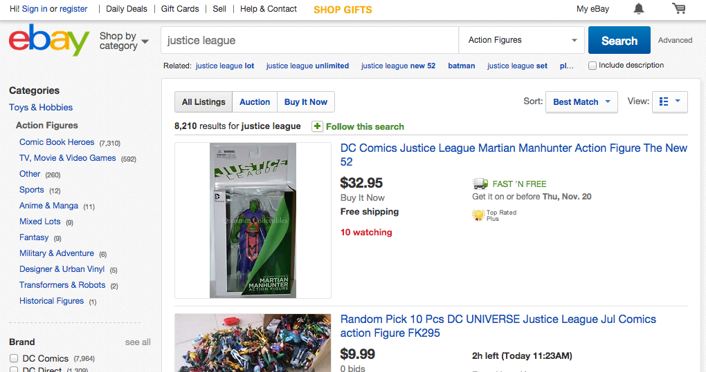
What if DOM objects contain DOM objects?
And all the objects have a click event handler?
Which one fires when you click the link?

Slide 5

Answer: They all fire!
But in what order?

Slide 6

Bubbling means inside out
IE decided that events should bubble
Innermost first, then move to outermost.
All modern browsers support bubbling

Slide 7

Capturing (aka. trickling) is outside in
Netscape decided that events should trickle
Outermost fires first, then moves to innermost
Designed to be able to intercept the event and optionally stop it from trickling further
Not all browsers support a capturing phase

Slide 8
To support all browsers, both were used
1
2
6
3
5
4
Notes:
We capture (aka. trickle) first and then bubble.

Slide 9
What you need for event handling
An object to attach to
The event to listen for
A function to bind
The event object to pass
The object
The event
The binding
The function
The event object

Slide 10
Four ways to wire them up
Type | Vehicle | Pros | Cons
IE 8 and below | e.attachEvent( 'onevent', function () {...}); | Works in IE 8- | Only works in IE 8-
HTML attribute | <e onevent="f()" /> | Simplest | Least flexible
DOM Level 0 style | e.onevent = function () {...}; | SOC | Old-school
DOM Level 2 style | e.addEventListener( event, function () {...}); | Most capable and flexible | Most typing
Notes:
We'll break these down on subsequent pages
SOC = Separation of Concerns
These are listed in worst to best order

Slide 11

IE 8 and below style
Obviated by addEventListener() in IE9
Completely removed in IE11
var btn = document.getElementById('btn');
btn.attachEvent('onclick', function (e) {
// Do stuff
});

Slide 12
HTML Attributes
Example:
<input type='button' onclick='doSomething()' value='Go' />
Sets the event handler.
Clobbers all old event handlers
Can only have one event
Notes:
Only the first one fires. Others are ignored.

Slide 13
DOM Level 0 Style
Example:
var btn = document.getElementById('btn');
btn.onclick = function (e) {
// Do stuff
}
Once again, not additive.
Notes:
Only the last one written wins. Each one clobbers the others before.

Slide 14
DOM Level 2 Style
Example
var btn = document.getElementById('btn');
btn.addEventListener('click', function (e) {
// Do stuff
}, false);
This is additive. It doesn't clobber!
The third argument, a bool says if we should capture
true = capture
false = bubble (the default)
Note: No "on"!

Slide 15
So many choices! Which one to use?
Fortunately this is an easy decision.
Use addEventListener()
If you must support IE8-, use something like this:
if (x.addEventListener)
x.addEventListener(...)
else
x.attachEvent(...)

Slide 16
removeEventListener
Only works with a named function...
const foo = (e) => { console.log('foo', e)};
btn.addEventListener('click', foo);
Then to remove it ...
btn.removeEventListener('click', foo);
Note: without a named function, it would have no way of knowing what to remove.

Slide 17
The Event object

Slide 18
function foo(e) {
// Do stuff
}
x.addEventListener('click',foo,false);
x.removeEventListener('click',foo,false);
- false is assumed. You can only remove it from the phase to which you added it.

Slide 19
Q: When you write a function to receive a parameter, how does that parameter get populated?
A: The caller passes it!
Example:
function addMember(newHero) {
sendNewHeroToServer(newHero);
console.log(newHero.name + "was added.");
}
var r = new Hero("Red Tornado");
addMember(r);

Slide 20
So where is the call for your handler?
You write the handler like this:
btn.addEventListener('click', function () {
// Handle the click
}, false);
Q: So who calls it?
A: The target object!
Unbeknownst to you, when the target calls the handler, it always passes an object to that handler...
The event object!
So the wireup should have a parameter to receive that object:
btn.addEventListener('click', function (evt) {
// Handle the click
}, false);

Slide 21
The event object is awesome!
Contains information about the event itself
Some example properties:
clientX
clientY
screenX
screenY
ctrlKey
shiftKey
altKey
metaKey
code
key
target
isTrusted
Some methods:
preventDefault()
stopPropogation()
And many more ...
Notes:
Note: IE 8- puts the event object on window (ie. window.object) instead of passing it in.
A control/shift/alt/meta key *does* fire an event. So does Esc/F1-F12, etc.
You *can* intercept events like meta-P for print, etc.
pageX and pageY:
Relative to the top left of the fully rendered content area in the browser. This reference point is below the url bar and back button in the upper left. This point could be anywhere in the browser window and can actually change location if there are embedded scrollable pages embedded within pages and the user moves a scrollbar.
screenX and screenY:
Relative to the top left of the physical screen, this reference point only moves if you increase or decrease the number of monitors or the monitor resolution.
clientX and clientY:
Relative to the upper left edge of the content area (the viewport) of the browser window. This point does not move even if the user moves a scrollbar from within the browser.
isTrusted:
true => user-generated. false => script-generated.

Slide 22
tl;dr
Event handling can be done in four ways:
In the HTML element itself (<div onclick="handler()">)
DOM Level 0: theDiv.onclick = handler;
DOM Level 2: theDiv.addEventListener('click', handler);
... and that other one we're trying to forget
The event object has lots of good information about the event.

Slide 23
Further Study
Notes:
pp. 29-34

Slide 24
json
Notes:
The Taladega Nights chapter

Slide 25
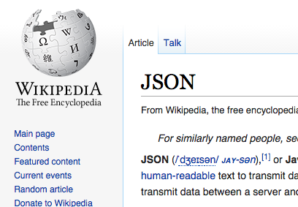
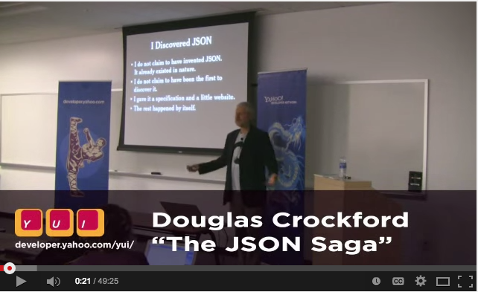
How do you pronounce 'JSON'?
Let's take on the burning question ...

Slide 26
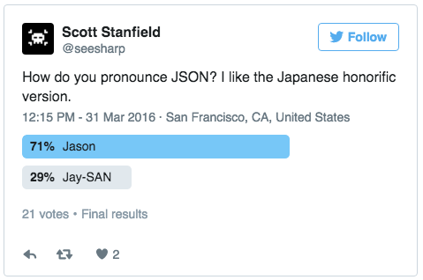
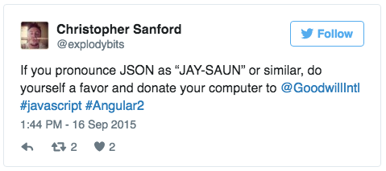
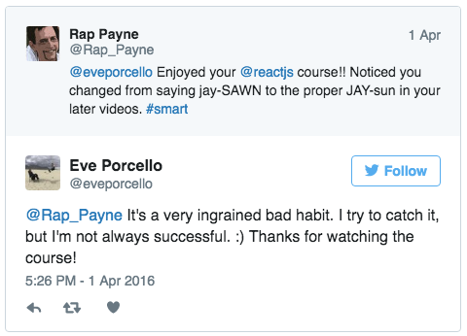
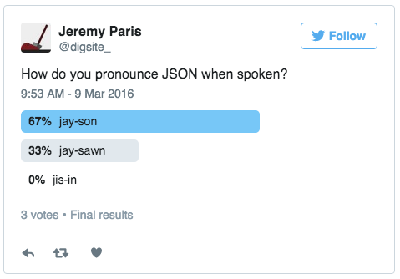

Slide 27

Other languages have classes
JavaScript has no 'class'
Objects are created at will

Slide 28
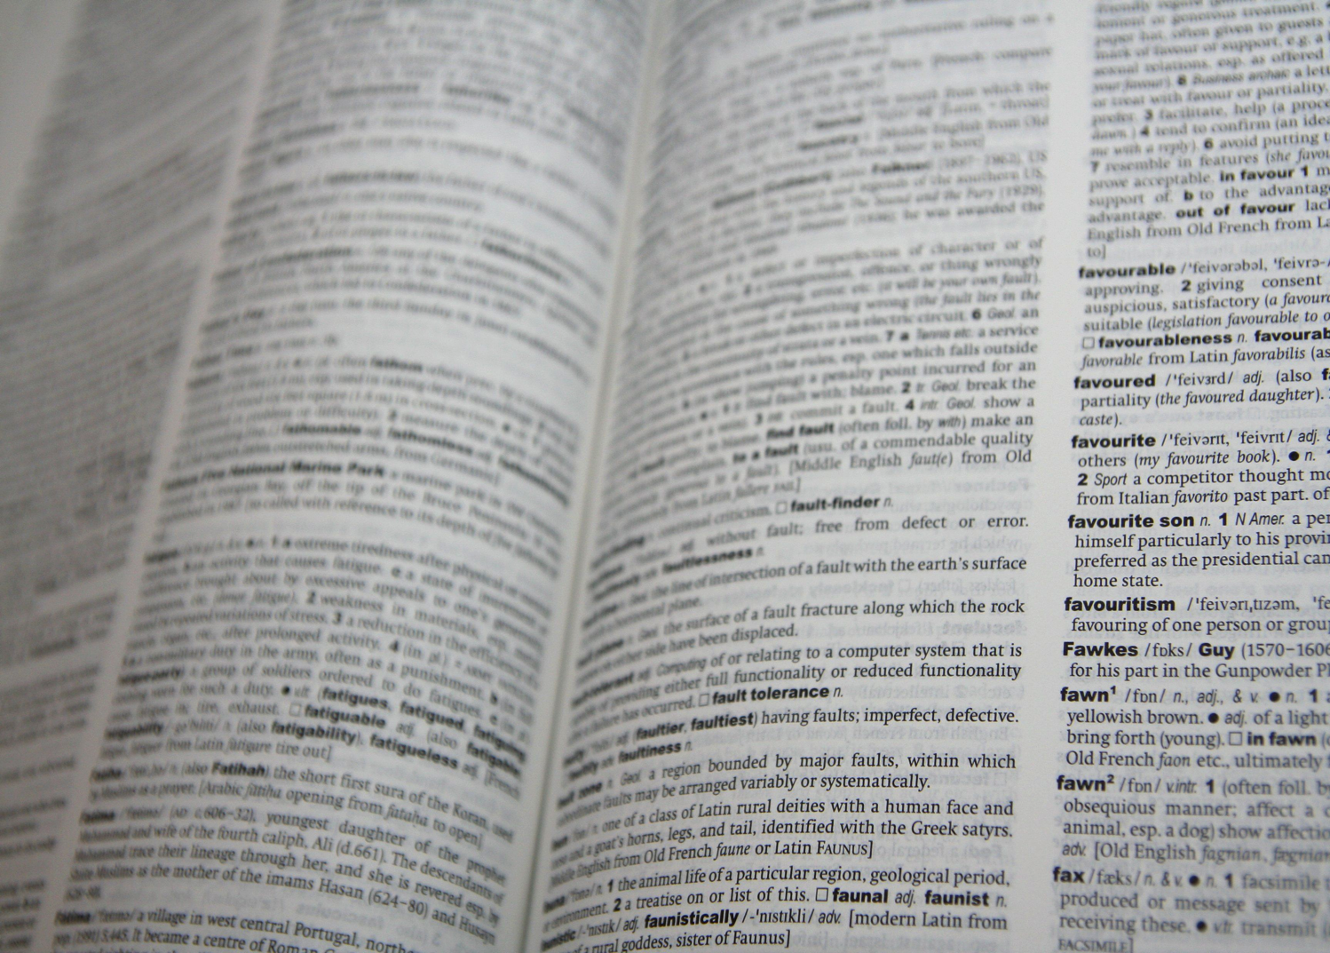
In JavaScript, objects are really hashes
Unordered key-value pairs

Slide 29
To create an object in JavaScript
var p = new Object();
Properties can be added at will:
p.firstname = "Jean";
p.lastname = "Girard";
p.nickname = "Frenchy";
p.carNumber = 55;
Or preferably:
var p = {};
p.firstname = "Jean";
p.lastname = "Girard";
p.nickname = "Frenchy";
p.carNumber = 55;
Notes:
This looks like a person object

Slide 30

And why would you want to have objects?
Working with it in a program
Storing data
Serializing and saving
Transferring data
Between organizations
Ajax!!

Slide 31
JSON is simply a way to represent an object
Like a person object whose
First name is "Cal"
Last name is "Naughton"
Nickname is "Magic Man"
Car number is 47
{
firstname: "Cal",
lastname: "Naughton",
nickname: "Magic Man",
carNumber: 47
}
Note the syntax:
The object is bounded by curly braces
Entries are comma-separated
Keys & values are colon-separated
Notes:
But isn't that exactly what XML is for?

Slide 32
Sounds like XML. Why not just use XML?
<person>
<firstname>
Cal
</firstname>
<lastname>
Naughton
</lastname>
<nickname>
Magic Man
</nickname>
<carNumber>
47
</carNumber>
</person>
{
firstname: "Cal",
lastname: "Naughton",
nickname: "Magic Man",
carNumber: 47
}
73 bytes
126 bytes
Notes:
50% larger!

Slide 33
Getting and setting values uses the dotted notation
To set
driver1.firstname = "Ricky";
To get
getElementById('outputDiv').innerText = "Coming in first place is " + driver1.lastname;

Slide 34
But you can use a bracket notation also
To set
driver1["firstname"] = "Ricky";
To get
var prop = "lastname";
getElementById('outputDiv').innerText = "Coming in first place is " + driver1[prop];
Dotted notation is generally preferred unless you're using a variable for the keyname.

Slide 35
Objects can contain anything
var team = {
name: "Dennit Racing", // A string
winsThisSeason: 12, // A number
owner: larry, // Another object
members: [ ricky, cal, jean ] // An array
score: function () {
return this.winsThisSeason * 1.5
} // A function
}

Slide 36
JSON to/from Strings

Slide 37


String to Object
var driver = getDriver(123); // This returns a string.
console.log(typeof driver); // "string"
console.log(driver); // '{"firstName":"Ricky"}'
console.log(driver.firstName); // undefined
driver is a string, but we need to get JSON data!
var obj = JSON.parse(driver); // *Now* obj is an object
console.log(obj.firstName); // "Ricky"
Notes:
If the string isn't in JSON format, it throws. Hard stop.

Slide 38
Object to String
Great for serializing an object.
console.log(typeof obj); // 'object'
console.log(obj.firstName); // 'Ricky'
var str = JSON.stringify(obj);
console.log(str); // '{"firstName":"Ricky"}'

Slide 39
You have control over the serialization
var o = {
firstName: "Rap",
lastName: "Payne", email: "rap@e.co",
toJSON: () =>
return { "first": this.firstName,
"email": "x@x.com" };
};
var s = JSON.stringify(o);
console.log(s);
// { first: "Rap", email: "x@x.com" }

Slide 40
tl;dr
JSON is a way to express objects in a concise way
JSON can contain anything
You get/set properties with the dotted notation
Great for storing data, transferring data, or just working with it in JavaScript

Slide 41
Further Study
The JSON Saga video as told by Doug Crockford
http://bit.ly/CrockfordOnJSON
The home of JSON
http://json.org/

Slide 42
Advanced JavaScript Basics
No, that's not an oxymoron
Notes:
The Breaking Bad Chapter

Slide 43
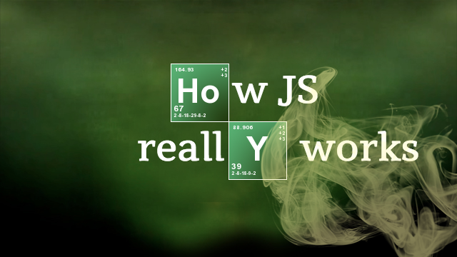
How JavaScript *REALLY* works
Some basic ideas that serious JavaScript developers need to know.
Notes:
Need to add
optional parameters

Slide 44
"use strict";

Slide 45
Strict mode ...
Protects us from doing stupid things we shouldn't be doing anyway.
To enable, just go ...
"use strict";
At the top of a script file or function
The quotes are weird but help with much older browsers.

Slide 46
What strict mode does (1 of 4)
Can't declare variables implicitly
Not okay:
x = "foo"; // ReferenceError
But this is cool:
var x = "foo";
strict disallows the with statement altogether (Yay!)
Notes:
Can't add variables to the global object (like this.foo="10")

Slide 47
What strict mode does (1 of 4)
Can't declare variables implicitly
Not okay:
firstName = "Skyler"; // ReferenceError
But this is cool:
var firstName = "Skyler";
strict disallows the with statement altogether (Yay!)
Notes:
Can't add variables to the global object (like this.foo="10")

Slide 48
What strict mode does (2 of 4)
Can't use certain reserved words in ES5
Not okay:
var protected = {
class: 1,
implements: 2,
interface: 3
};

Slide 49
What strict mode does (3 of 4)
eval() works but is restricted
All variables in an eval are local. Prevents hackers from running certain XSS attacks.
But eval() is ugly even without security issues, so avoid it.

Slide 50
What strict mode does (4 of 4)
It won't let you alter arguments
Which shouldn't be reassigned anyway
function foo(x) {
x = "foo"; // x will change, but
// arguments[0] will not
arguments = [ 1, 2, 3 ]; // Error
}
Notes:
Note: there are other things as well.

Slide 51
What strict mode does (4 of 4)
It won't let you alter arguments
Which shouldn't be reassigned anyway
function bake(size) {
size= "20 lbs"; // size will change, but
// arguments[0] will not
arguments = [ 1, 2, 3 ]; // Error
}
Notes:
Note: there are other things as well.

Slide 52
Can't use the same property in an object twice
var x = { foo: 1, foo:"bar" };
Can't use the same parameter name
function (foo, foo) { ... }

Slide 53
Functions are variadic

Slide 54

All parameters are optional in JavaScript. No error is thrown if you call the function with too many or too few parameters.
TOO MANY PARAMETERS!
Chill ... this is JavaScript.
May want to check them ...
if (x == undefined) {
x = 0;

Slide 55
arguments allows access to all parameters
Every function has an arguments object
function printAllParms() {
for (var i=0 ; i<arguments.length ; i++) {
console.log(arguments[i]);
}
}
Notes:
Considered harmful ... users of the function don't know how to call it without reading comments.

Slide 56
Rest parameters may help with too many arguments
function sum(...nums) {
let total = 0;
nums.forEach(x => total += x);
return total;
}
arguments is array-like. nums is a true array.

Slide 57
Default parameters may help with too few
function foo(first="John",
last="Doe", age=getVotingAge()) {
// Do stuff with first, last, and age here
}
If you supply a value it'll be used. If not, the default value is.
Allows you to pass in null, "", 0, or false as valid values and have them used.

Slide 58
Hoisting

Slide 59
What happens to x?
1 var city = document.getElementById('city').value;
2 if (city === 'Albuquerque') {
3 var x = 10;
4 }
5 console.log("x is ", x);
What happens on line 5?
A) x is always 10
B) x may be 10 or it may be undefined
C) A ReferenceError is thrown
Notes:
Answer: B. If the user enters "Albuquerque", it'll be 10. Otherwise, x is undefined.
The point is that JavaScript doesn't honor block scope.

Slide 60

The var statement hoists
function () {
//Statements
var x = 10;
}
... becomes ...
function () {
var x = undefined;
//Statements
x = 10;
}
Notes:
Declares and initializes variables within a function.
Declaration gets hoisted
initialization turns into an ordinary assignment;

Slide 61
Remember ... let and const do not hoist
1 function foo() {
2 if (price < 200) {
3 var shouldSell = false;
4 const makeLess = true;
5 let capacity = oldCapacity - 10;
6 }
7 }
Hoisted
Stay put

Slide 62
Function statements vs. function expressions

Slide 63
Expressions!!
Consider ...
var x = 5;
var x = 'a string';
var x = new Date();
var x = ['Walt','Jesse','Skyler'];
var x = {};
What do you call the things on the right?

Slide 64
JavaScript has a function expression
function (params) {
body here
}
Keyword function
Name is optional
Zero or more parameters
Bound by parentheses
Separated by commas
Body
Bound by curly braces
Zero or more statements

Slide 65
Functions are objects! You can ...
// Assign to a variable
var x = function () { doSomething() };
// Pass them as arguments
doSomethingElse(x);
// Return them from other functions
function foo() {
return function () { doThings(); };
}
// Put them in arrays
var arrayOfFunctions = [ x, y, z ];
// ... and more!!

Slide 66
The function statement
function foo() {
}
... is more like ...
var foo = function () { ... };
But both parts are hoisted

Slide 67
Execution context
Where a function runs depends on how it is invoked

Slide 68
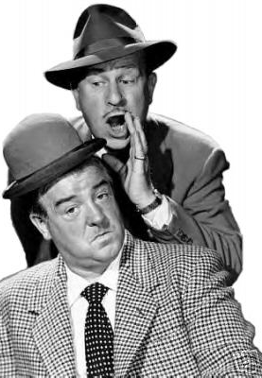
The this variable refers to the current context (environment)
Costello: My code doesn't work
Abbott: I see the problem. this is wrong.
Costello: I know. What's the issue?
Abbott: this. You're misusing this
Costello: I'm misusing what?
Abbott: No, you're misusing this.
Costello: Well are you going to tell me what's the problem or aren't you?
Abbott: I am. You're misusing this.
Costello: Exactly where's the issue in my code?
Abbott: No, not where ... this.
...

Slide 69
Meaning depends on context
Bad
Good
His feelings were crushed when she left.
Is it me or was that waiter salty to us?
He crushed it in the 4th quarter!
The bisque was delicious! So salty!

Slide 70
Running functions have a context
The function accesses its context via "this"
How you call a function changes "this"

Slide 71
4 ways to invoke a function
Method form
Call form
Function form
Constructor form
Notes:
Covered very well in Chapter 4 of JavaScript: The Good Parts

Slide 72
Say you have a shopping cart ...
console.log(cart);
[{
qty: 5,
item:{id:59,desc:'jelly beans',price:2.12}
},{
qty: 1,
item:{id:844,desc:'rice',price:3.25}
},{
qty: 5,
item:{id:562,desc:'apples',price:2.75}
}]

Slide 73
... And a calcTotal() function
function calcTotal(prefix) {
const sum = this.reduce((prev, curr) =>
prev + curr.qty * curr.item.price, 0);
return prefix + sum;
}
How this runs depends on what this is
Notes:
Note: reduce is ES2015 to iterate over an array and run a process on each.

Slide 74
Method form
The function is already part of the object on which it is working
Example
cart.getTotal = calcTotal;
var tot = cart.getTotal("CAD$");

Slide 75
Call Form
With these, the context is passed in to the function.
Syntax:
function.call(context, parm1, parm2 ...)
Pass in any number of parameters
function.apply(context, [parm1, parm2 ...])
Pass in an array of parameters
Examples:
let tot = calcTotal.call(cart, "US$");
let tot = calcTotal.apply(cart, ["€"]);
Notes:
Mnemonic ...
Call -> "C" -> commas
Apply -> "A" -> array

Slide 76
Function form
Simply ... call it!
Example:
calcTotal();
Fails b/c window isn't a cart. What's a qty? What's an item? What's a price?
Notes:
Warning! If 'use strict';, then this is undefined.

Slide 77
Crockford says
When a function is invoked with this pattern, this is bound to the global object. This was a mistake in the design of the language. Had the language been designed correctly, when the inner function is invoked, this would still be bound to the this variable of the outer function.
Sort of fixed by using the ES2015 Arrow operator. When you define a function in that way, this is bound to the caller's context.

Slide 78
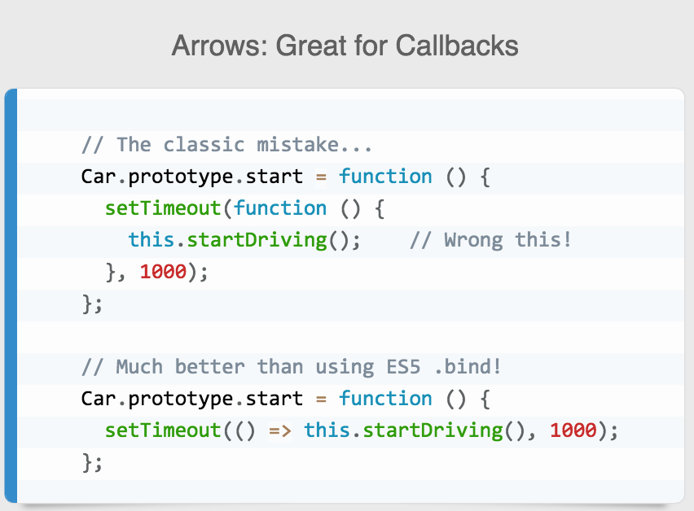

Slide 79
A note about pure functions
They don't change anything outside of them.
All values are passed in and a value is passed out
Example ...
function calcCartTotal(c, prefix) {
const sum = c.reduce((prev, curr) =>
prev + curr.qty * curr.item.price, 0);
return prefix + sum;
}
const total = calcCartTotal(cart, "£");

Slide 80
Constructor form
You can "new" up a function ...
When you use new,
An empty Object is created
It replaces window as the context
"this" refers to that new context
The lines in the function are run in this context
That new context is returned

Slide 81
Constructor form example
function Item(itemId) {
var _item = getItemViaAjax(itemId);
this.id = itemId;
this.price = _item.unitPrice;
this.desc = _item.description;
}
var cart = [
{qty: 5, item: new Item(59)},
{qty: 1, item: new Item(844)},
{qty: 5, item: new Item(562)}
];

Slide 82
Summary
Form | Example | this
Method | obj1.foo(); | obj1
Function | foo() | global
Constructor | newObj = new foo(); | the instantiated object
Call | foo.call(obj1, p1,p2, ...); foo.apply(obj1, [p1, p2, ...]); | obj1

Slide 83
Bind
Bind is a whole new ballgame
Good for currying (recursively calling functions to avoid loops - a big part of functional programming.)
var getTotalInDollars = getTotal.bind(cart, "$");
var getTotalInEuro = getTotal.bind(cart, "€");
const msg = "Order total: " + (inUS) ? getTotalInDollars() : getTotalInEuro();
Notes:
Included here because bind() is often confused with call()/apply().

Slide 84
Create a jsbin with a function call,
Going to struggle with showing use cases. Need to tell a story.
Great post: http://geekabyte.blogspot.com/2013/09/how-to-use-call-apply-and-bind-in.html
Look here: http://blog.i-evaluation.com/2012/08/15/javascript-call-and-apply/
Good, too: https://codeplanet.io/javascript-apply-vs-call-vs-bind/

Slide 85
The Event Loop

Slide 86
Describe how JavaScript handles async
It doesn't! It uses an event loop.

Slide 87
JavaScript is single-threaded
It is not multithreaded
It can never block!

Slide 88
console.log(1)
setTimeout(1000, console.log(2))
console.log(3)
setTimeout(0, console.log(4))
console.log(5)
console.log(6)
console.log(7)

Slide 89
Other stuff

Slide 90
()
This is an operator, a suffix operator.
When this is seen, it means to invoke it
Show examples with and without here

Slide 91
tl;dr
JavaScripts hoist all variable declarations
It also hoists function statements
Function expressions omit the name of the function.
Function statements include them.

Slide 92
Unit Testing JavaScript
Notes:
The Star Wars chapter

Slide 93
Component parts
Framework
Holds the tests and groupings/modules (describe, ...)
Mocha, QUnit, Jasmine
Assertions
The tests themselves (assert, expect, should ...)
Chai, NodeJS has some built-in
QUnit and Jasmine have these built-in
Runner
How you run the tests at run-time
Browsers - You navigate to the page
PhantomJS

Slide 94
A unit test tests one unit of work
One requirement for one method
They are:
Isolated from other code
Isolated from other developers
Targeted
Repeatable
Predictable
Notes:
You can focus on only that one thing
If anything goes wrong, you know where the problem is

Slide 95
What is NOT unit testing? ... Anything else!
> 1 requirement
> 1 method
> 1 project
> 1 system
Affects > 1 developer
Notes:
You lose focus as a tester
No crossing boundaries
If you can't get a test down to one thing, you've probably violated SRP. All future tests will be brittle and confusing

Slide 96
Benefits of unit testing
Fewer errors
Better designed
Unit testing requires good practices
Repository pattern
Dependency injection
Inversion of Control
Single responsibility
Built-in regression testing
Puts a stop to recurring bugs
When you discover a bug you write tests there and elsewhere to detect that same error
Notes:
p. 9 - 10

Slide 97

It starts with the test
Notes:
p. 75
In TDD, you write the tests before you even write the code
As you're writing tests, you discover other parts of the system that need to be written … especially at first. Requirements-driven and test-driven

Slide 98
Benefits of TDD
All the benefits of unit testing plus …
It becomes hard to create errors in the first place
You almost have to try to create errors
Better matches the business requirements
It does what it is supposed to do
It must because we only write tests that satisfy requirements
Encourages communication with the business
It eliminates gold plating
Notes:
Remember the benefits of Unit testing are:
Fewer errors
Better designed
Unit testing requires good practices
Repository pattern
Dependency injection
Inversion of Control
Single responsibility
built-in regression testing
Puts a stop to recurring bugs
When you discover a bug you write tests there and elsewhere to detect that same error

Slide 99



Red, green, refactor
asdf
Notes:
p. 76
When you write that first test, it fails. Why? Because the functionality doesn't exist yet.
Then you write the code to make it pass

Slide 100
The red phase
Notes:
p. 77
1. Write the test. Doesn't compile … why? b/c method doesn't exist yet.
2. Write the method stub. Doesn't compile … why? b/c no return value.
3. Put throw new NotImplementedException() in.
4. Replace that with a naïve implementation to move to green
In doing this, you also create stubs and code for services and DB calls. Keep writing until test passes.

Slide 101

You want to write positive tests and negative tests
Negative tests involve values that are outside acceptable ranges.
They should fail
You're testing to make sure that they do
Positive tests are ones that should pass
Notes:
Not in book

Slide 102
The green phase
Notes:
p. 78
Naïve implementation – Just enough code to get it to work, but no more.
YAGNI
Simple at first because you know you'll refactor mercilessly very soon.
You're delivering software that … WORKS!

Slide 103
The refactoring phase
Notes:
p. 79
Note: not happy with the yellow light b/c it makes you think of the yellow light in NUnit. The two are not related.
Now you add readability, maintainability, code quality
Beauty of it all is that the unit tests ensure that your code still works!

Slide 104

Once finished you pick up a user story and start again writing a new failing test

Slide 105
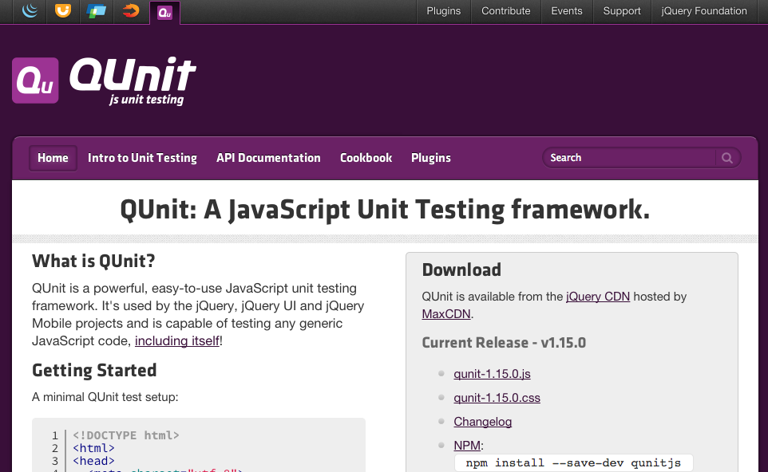
QUnit is a unit testing framework for JavaScript
Built by the jQuery team
Notes:
Originally built by John Resig himself
Used to test jQuery
No dependencies anymore

Slide 106

To get it, download and save two files
qunit.js
qunit.css
Well, that was easy!
Notes:
Or you can just run them from the CDN – also found on the first page.

Slide 107
Make a testrunner
<!DOCTYPE html>
<html>
<head>
<meta charset="utf-8">
<title>QUnit Example</title>
<link rel="stylesheet"
href="//code.jquery.com/qunit/qunit-1.22.0.css">
</head>
<body>
<div id="qunit"></div>
<div id="qunit-fixture"></div>
<script
src="//code.jquery.com/qunit/qunit-1.22.0.js">
</script>
<script src="tests.js"></script>
</body>
</html>
Notes:
Note the urls starting with "//"

Slide 108
Define tests using QUnit.test()
Syntax
QUnit.test(title, testFunction);
Example
QUnit.test("Lightsabre blocks blaster ray",
function (assert) {
var s = new Lightsabre('Quigon');
var blaster = new Blaster('battledroid1');
var result = s.block(blaster.fire());
assert.equal(result, true);
});
Notes:
Note the "assert" object that must be passed in.
You'll have many tests! At least one per requirement. Usually >1 per requirement.

Slide 109

The assertions are pretty simple
deepEqual(actual, expected)
equal(actual, expected)
expect(number)
notDeepEqual(act, expected)
notPropEqual(act, expected)
notStrictEqual(act, expected)
notEqual(actual, expected)
ok(bool)
propEqual(actual, expected)
push()
strictEqual(actual, expected)
throws(actual, expected)
Notes:
Break these down on next pages

Slide 110
The most basic check is ok()
If the parameter passed is truthy, it passes
If not, it fails
Syntax
assert.ok(parameter)
Example
QUnit.test("Death Star is really big", function (assert) {
assert.ok(this.deathStar.getSize() > 1e25);
}

Slide 111



How to test for equality
equal(a, e) | strictEqual(a, e) | deepEqual(a, e) | propEqual(a, e)
Makes sure the actual value and the expected value are the same. Like "==". | Like equal but uses "===" | Like equal but for objects. Checks all values at all depths. Uses "==". | Like deepEqual() but checks all values using "==="
notEqual(a, e) | notStrictEqual(a, e) | notDeepEqual(a, e) | notPropEqual(a, e);
Notes:
equal(a, e) is used for simple values like strings and numbers. deepEquals(a, e) is for objects.

Slide 112
throws() makes sure an Error was thrown
Syntax
assert.throws(function[, expectedError][, expectedMesg]);
Example
QUnit.test("Attacking a fellow Jedi throws error",
function (assert) {
assert.throws(function () {
var luke=new Jedi('Luke Skywalker');
var mace = new Jedi('Mace Windu');
luke.attack(mace);
}, /traitor/);
});
The highlighted function above is expected to throw an error with a message that contains the regular expression "traitor".
If not, the unit test fails.
Notes:
Of course this would fail anyway since Luke wasn't born until after Mace Windu had died.

Slide 113
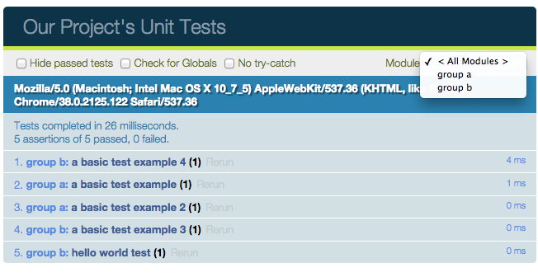
We can organize our runs with modules
Run each group separately if you like.

Slide 114
QUnit.module creates those modules
QUnit.module("group a");
QUnit.test( "a basic test example", function(assert) {
assert.ok( true, "this test is fine" );
});
QUnit.test( "a basic test example 2", function(assert) {
assert.ok( true, "this test is fine" );
});
QUnit.module("group b");
QUnit.test( "a basic test example 3", function(assert) {
assert.ok( true, "this test is fine" );
});
QUnit.test( "a basic test example 4", function(assert) {
assert.ok( true, "this test is fine" );
});

Slide 115

Setups and teardowns
Syntax
QUnit.module(name[, lifecycleObject]);
where lifecycle object is a JSON object:
{
"beforeEach": function () { /* Do setup things here. */},
"afterEach": function () { /* Do teardown things. */}
}
Notes:
The setup function is run before each test
Teardown is run after each test

Slide 116
Shared variables
You can also have shared variables if you define them in the lifecycleObject:
QUnit.module("Sith Object Tests", {
beforeEach: function () {
this.master= new Sith('Darth Sidius');
this.vader = new Sith('Darth Vader');
this.master.setApprentice(this.vader);
}
});

Slide 117
You run your tests by just visiting the page

Slide 118
tl;dr
TDD is a great idea
Unit testing is the cornerstone of TDD
TDD = Red, green, refactor
QUnit is a unit testing framework for JavaScript.
It provides a testing framework with a runner
QUnit has assertions (ok, equal, deepEqual, etc.)
You can group your tests into modules with QUnit

Slide 119
Further study
Get QUnit from qunitjs.com
http://qUnitjs.com
Great documentation on QUnit
http://api.QUnitjs.com

Slide 120
Oh! and one more thing
jslint

Slide 121
JSLint can be a bit touchy about the results it returns and — as its developer Douglas Crockford says — it can hurt your feelings. I found myself write much better code however, since I installed the TextMate JS bundle and started subjecting my code to JSLint scrutiny.
Clean and valid code means less confusing bugs to fix, easier handover to other developers and better code security. When you rely on hacks to get your code to work it is likely that there is also a security exploit that uses the same hacks. In addition, as hacks get fixed in browsers, your code will cease to work in the next version of the browser.

Slide 122
Declared Objects
Notes:
Family Guy

Slide 123
Overview
There are generally two types of objects
Declared
One copy
Like a static object
Created
Is instantiated
Like an instance object
Notes:
This chapter is for the declared ones.

Slide 124

Q: Why do we code in an object-oriented way?
A: Because it works!
Why? What are the advantages?
Notes:
Encapsulation
Abstract code
design patterns

Slide 125
Reminder: Objects and Classes
Objects are created on the fly using _________
Objects are really just _____-________ pairs
Another name for this is a _________.
Notes:
JavaScript has no class
Objects are created on the fly using JSON
Objects are really just key-value pairs
Another name for this is a hash (or dictionary)

Slide 126
To be OO, we need certain things
Objects
Classes
Properties
Methods
Constructors
Encapsulation
Private members
Public members
Static members
Accessor functions
Overloading
Inheritance
Overriding
Interfaces
Namespaces
Notes:
JavaScript has NONE of these things

Slide 127
Need to add static members to the OO list
Functions are objects so they can have properties and functions
function Foo() {
this.increment = function () {
Foo.bar++;
}
}
Foo.bar = 1;
var foo = new Foo();
foo.increment();
console.log(Foo.bar);

Slide 128
JavaScript has no ...
True classes
Traditional inheritance
Overloading
Polymorphism
Interfaces
Namespaces

Slide 129

JavaScript is not object-oriented
Or is it?
Notes:
Great time for a debate. If it doesn't have these things, it isn't OO.
But what if it can simulate them. Can it be OO then?

Slide 130

But we can simulate most of the OO behaviors
Notes:
Let's cover each concept and see how we can simulate them.

Slide 131
Objects

Slide 132

We create objects on the fly … no need for classes
var obj = {
firstName: "Meg",
lastName: "Griffin",
pathology: "Rejection"
};
Notes:
Object literal

Slide 133
Two ways to create objects
var o = new Object();
var o = {};
Notes:
FFT: Which is better? (Second is recommended).
Note: Object is a function and object is a type.

Slide 134
Properties

Slide 135
Properties are similarly created dynamically
var person1 = {
lastName: "Griffin",
firstName: "Stewie",
city: "Quahog",
state: "RI"
};
document.write("The person is " + person1.firstName + " " + person1.lastName);
document.write("He is from " + person1["city"]);
var prop="state";
document.write("He lives in " + person1[prop]);
Notes:
Note that an object is really just an array with words for the index.

Slide 136

We can loop over the properties in an object
for (var propName in person1) {
console.log(propName, person1[propName]);
}
Notes:
Properties are enumerable (for-in) but not iterable (for-of)

Slide 137
Remember, objects can contain anything
var family = {
name: "The Griffins", // A string
incomeInDollars: 34000, // A number
dog: brian, // Another object
parents: [ peter, lois ] // An array
playTheme: function () {
return "It seems to me " +
"that all you see is ...";
} // A function
}

Slide 138
How can I see if an object has a given property?
The in operator
if ('neighbor' in family) { ... }
//It has a family.neighbor property
else
//It does not.
Even if it is undefined, it is there.
This is better than looking for truthiness since it would return a false negative if family.neighbor is 0 or ""

Slide 139
Methods

Slide 140
Functions are objects themselves
So they can be passed around like data
btn.addEventHandler('click',function () {
// Do stuff
});
They can be assigned to a variable
var doStuff = function () { // Do stuff });
... Even a property in a JSON object
var family = {
...
playTheme: function () {
return "It seems to me " +
"that all you see is ...";
}
}

Slide 141

So to run that last function, we'd have to go ...
A method!!
var x = family.playTheme();

Slide 142
Overloading

Slide 143
JavaScript is weird about function parameters, too
All arguments are optional by default
If you don't supply a value, it becomes undefined
If you supply extra arguments, they are silently ignored
Arguments are dynamically-typed

Slide 144
So, we sort of get overloading for free
If we do this:
function x(a, b, c) { // Do stuff with a, b, & c }
These all work:
x(1, 2, 3);
x(1);
x(); // a, b, and c are all undefined
x(1, 2, 3, 4, 5, 6, 7, 8); // Extras are ignored
So
function x(a, b, c) {
if (b) { doSomethingWithB(); }
if (c !== undefined) { doSomethingWithC(); }
doOtherThings();
}
Notes:
Note that if the user passed in a 0, "", false, null this will result in skipping the block (ie. doSomethingWithB() will not be called.
c !== undefined checks for exactly nothing being passed in.

Slide 145
Bonus info! Two ways to loop through indeterminate number of parameters
Rest parameters convert any number of args into an array
function func(...rest) {
for (var thing of rest) {
console.log(thing);
}
}
The arguments object holds all the parameters passed in
function func() {
for (var x=0; x < arguments.length; x++) {
console.log(arguments[x]);
}
}
Notes:
arguments looks like an array but it technically isn't
You can convert it to a real array like so:
var args = arguments;

Slide 146
Object Immutability
Freezing objects

Slide 147
Sometimes we want an object frozen
For certain libraries
(React.js, etc)
Pure functions
Coding rigor

Slide 148
Object.freeze(theObject)
var o = { foo: "bar" };
o.baz = "x"; // Works
Object.freeze(o); // Now it is frozen
o.foo = "y"; // Fails silently
o.z = "a"; // Fails silently
Notes:
Notes:
if o.x = {}; and you o.x.foo="bar";, this works; it isn't deepfreeze.
If 'use strict' is on, then they don't fail silently, they throw a TypeError.

Slide 149
To be OO, we need certain things
Objects
Classes
Properties
Methods
Constructors
Encapsulation
Private members
Public members
Static members
Accessor functions
Overloading
Inheritance
Overriding
Interfaces
Namespaces
Notes:
JavaScript has NONE of these things but they can be faked

Slide 150
tl;dr
JavaScript may not have classes, but it does have objects
Objects can be created on the fly like a hash
The key-value pairs act like properties
When we use functions as a value, it sure looks like a method.
We can even create ersatz overloads when we remember that parameters are optional always

Slide 151
Further Study
Two articles on importance of JavaScript
http://freshbrewedcode.com/jimcowart/2012/09/01/is-javascript-tragically-important-2/
http://www.simple-talk.com/opinion/opinion-pieces/a-sudden-move-one-developer%E2%80%99s-journey-from-c-to-javascript/?utm_source=simpletalk&utm_medium=email-main&utm_content=suddenmove-20121224&utm_campaign=opinion
Notes:
pp. 29-34

Slide 152
OO JavaScript – Created Objects
Notes:
Batman

Slide 153
To be OO, we need certain things
Objects
Classes
Properties
Methods
Constructors
Encapsulation
Private members
Public members
Static members
Accessor functions
Overloading
Inheritance
Overriding
Interfaces
Namespaces
Notes:
JavaScript has NONE of these things

Slide 154
Did you notice that with JSON there's no need to write a class first?
Java
JavaScript
public class Car {
private Engine _engine;
public Engine getEngine()
{
return _engine;
}
public void setEngine(Engine engine)
{
_engine = engine;
}
}
Then later …
Car c = new Car();
c.setEngine(new Engine("Hemi"));
var c = {
Engine: { type: "Hemi"}
}
console.log(c.Engine);
Notes:
class is a reserved word, but it is unused until ES2015.

Slide 155

JavaScript has no class
But I want classes!
You can't have true classes
JavaScript is not truly object-oriented
It just looks like it

Slide 156

And now, back to our regularly scheduled program ...

Slide 157
Classes

Slide 158

JavaScript's new operator works with functions
When you use new,
An empty Object is created
It replaces window as the context
"this" refers to that new context
The lines in the function are run in this context
That new context is returned
The object's type is its constructor function
For example:
function SuperHero() { ... }
var batman = new SuperHero();

Slide 159
The this variable refers to the current context (environment)
Costello: My code doesn't work
Abbott: I see the problem. this is wrong.
Costello: I know. What's the issue?
Abbott: this. You're misusing this
Costello: I'm misusing what?
Abbott: No, you're misusing this.
Costello: Well are you going to tell me what's the problem or aren't you?
Abbott: I am. You're misusing this.
Costello: Exactly where's the issue in my code?
Abbott: No, not where ... this.
...

Slide 160
A bad example of a function
var person = function (first, last, alias) {
this.firstName = first;
this.lastName = last;
this.alias = alias;
this.move = function (speed) { // Do stuff to move }
this.attack = function (foe) {
var d = `${this.alias} is attacking ${foe.alias}`;
console.log(d);
// Do other attacking stuff here
}
}
// Run it
person("Ed", "Nigma", "Riddler");
attack(batgirl);
Notes:
"this" is the window, so "attack()" is created on the global object.
If you're asking why we'd ever do this, you're thinking right. Be patient we're building to something.

Slide 161
Thus, functions come in two flavors:
Some you run
Some you make copies
Traditional functions
function punch(t) {
t.damage(10);
}
Run it like this:
punch(riddler);
With the new operator
function Villain(name) {
this.name=name;
this.power=10;
this.health=10;
}
Run it like this
v = new Villain('Bane');
Notes:
You never mix them.
Never "run" the kind on the right. Never "new up" the kind on the left.
It isn't a syntax error, but the developer has an intent for that function, so don't violate it.

Slide 162
Let's look again at our example function
var Person = function (first, last, alias) {
this.firstName = first;
this.lastName = last;
this.alias = alias;
this.move = function (speed) { // Do stuff to move }
this.attack = function (foe) {
var d = `${this.alias} is attacking ${foe.alias}`;
console.log(d);
// Do other attacking stuff here
}
}
var p = new Person("Oswald","Cobblepot","Penguin");
var n = new Person("Dick","Greyson","Nightwing");
p.attack(n); //Will log "Penguin is attacking Nightwing"

Slide 163

Those are classes!
Whoa! Those look just like classes!
Notes:
Image courtesy pixgood.com

Slide 164
Each object knows it's constructor
function attack(otherPerson) {
if (! (otherPerson instanceof Person)) {
throw "That's not a person";
}
// Do stuff here
}
Syntax:
object instanceof ConstructorFunction
Returns a bool
Note: "of" is not camel-cased
Notes:
instanceof climbs the prototype chain

Slide 165
Encapsulation

Slide 166
Say you have this code ...
var c = new Person("James", "Gordon", "Commissioner");
var runTime = new Date();
function showInfo(person) {
return `${person.alias} created at ${runTime}`;
}
alert(showInfo(c));
Notes:
Note the variable runTime

Slide 167
But we are using a library that does this
var runTime = programEnd - programStart;
What happens to runTime?

Slide 168

We've polluted the global namespace
Notes:
... and the library has as well.
FFT: Remind me ... how do you make a variable private? (precede with "var" and put it in a function).

Slide 169
We can make it private
function buttonClick() {
var c = new Person("James", "Gordon", "Commissioner");
var runTime = new Date();
function showInfo(person) {
return person.alias + " created at " + runTime;
}
alert(showInfo(c));
}
buttonClick();
Now runTime is local and a different variable than the library's copy

Slide 170
It is possible to have public variables and private variables in the same function
Private | Public
Put 'var' in front of the variable | Just omit the 'var'
var x = 5; var firstName = firstName; var defend = function () { ... }; | x = 5; // Global! Bad idea this.firstName = firstName; this.defend = function () { ... };

Slide 171
Accessors

Slide 172

Setters and Getters
JavaScript 5 doesn't have accessors (getters/setters) either

Slide 173
But we can easily write them
var Person = function (first, last, alias) {
this.firstName = first;
this.lastName = last;
this.alias = alias;
this.move = function (speed) { // Do stuff to move }
this.attack = function (foe) {
var d = this.alias + " is attacking " + foe.alias;
console.log(d);
// Do other attacking stuff here
}
var hidden = 5;
this.getHidden = function () { return hidden; }
this.setHidden = function (newValue) {
hidden = newValue;
}
}
Notes:
These are known as privileged functions. They can access private variables, so we just allow them

Slide 174
Constructors

Slide 175
What do we mean by "constructor"?
OO World (Java, C#, C++)
JavaScript world
"Constructor" means ...
A method in the class that is called once upon instantiation.
It is a single method
For initializing properties on the object
"Constructor" means ...
A function intended to be used with the new keyword to instantiate an object
It is the entire function
class Weapon {
public Weapon(string N) {
this.Name = N;
}
}
function Weapon (N) {
this.Name = N;
}

Slide 176
Traditional OO Constructors
function Car() { // private property var color = ''; // private constructor var Car = function() { alert("Car object was instantiated."); color = 'Red'; }() // <-- The parens make it run upon instantiation
// getter this.getColor = function() { return color; } // setter this.setColor = function(data) { color = data; } }
Notes:
http://jsfiddle.net/rapPayne/VKXGs/
Note: the "var Car" is unneeded and unused. Could be omitted and replaced with an IIFE.
You can also just put the lines outside of any function and they're run.

Slide 177
Static (Shared) Members

Slide 178
Static? What's static?
"static" ==> Only need one copy of it.
"shared" ==> Something they all share. Everyone has access to the same thing.
An example in C#:
public class Person
{
public static int NumberOfPeople { get; set; }
public string FirstName { get; set; }
...
}
To access:
int n = Person.NumberOfPeople;

Slide 179
Remember, in JavaScript ...
Functions are objects
Objects can have properties
Properties are added dynamically
Therefore ...
function Person() {
...
}
var n = Person.numberOfPeople;

Slide 180
Interfaces

Slide 181

Yeah. JavaScript has no interfaces
Notes:
It arguably doesn't need them because it would be just as easy to check for the existence of a function as it is to check an interface.
Duck typing
TypeScript can have them b/c they're enforced at compile time, not runtime.

Slide 182

ES2015 Classes

Slide 183
ES2015 gives us a different way to write this
Note: methods don't need this. nor the function keyword
class Person{
attack() {
// Do stuff in this method
}
}
Still not real classes, though!
Just syntactic sugar on top of a constructor function
Notes:
Note: classes are block scoped and are not hoisted (unlike functions)
No change except new keywords and streamlined notation
We are not even close to embracing traditional classes.
Can NOT have class Person(first, last). syntax error. Can put that in a constructor, though.
Can NOT call a class as a function: Person() - TypeError
When you create a method on a class, it really adds it to the prototype of all the objects created from it.

Slide 184



class is there to make OO devs feel better
All you’re doing when you create a class is opting into a less powerful, less flexible mechanism and a whole lot of pitfalls and pain. (sic)
I think classes in ES6 are a bad part because they lock you into that paradigm.
Any time you can write a function instead of a class, do.
Eric Elliott - Big-brained JavaScript blogger
Douglas Crockford - JavaScript -- The Good Parts
Dan Abramov - Creator of Redux.
Notes:
From here: https://github.com/joshburgess/not-awesome-es6-classes

Slide 185
Mixing es5 and es2015 styles work if you're really careful. So why would you do it?

Slide 186
There are no true privates, even if you have the "_foo" backing variable. it is still exposed.

Slide 187
Or ...
Object.defineProperty(Circle, "circlesMade", {
get: function() {
return !this._count ? 0 : this._count;
},
set: function(val) {
this._count = val;
}
});

Slide 188
ES2015 adds getter and setters
class Person {
...
get alias() { return this._alias; }
set alias(newValue) {
this._alias = newValue;
}
move(speed) { // Do stuff to move }
attack(foe) {
let d = `${this._alias} is attacking ${foe.alias}`;
// Do other attacking stuff here
}
}
const p = new Person();
p.alias = "Joker"; // Calls set
console.log(p.alias); // Calls get
Notes:
Accessors are called whether setting/getting from within the class or from without
You're going to need a backing value (like _first). No way around that.
Skip unless asked ... The backing variable can still be accessed directly, bypassing the getter/setter.
Solution: Put the inside of the class in a closure object and return that object. Use var/let inside the object.
See here: http://derickbailey.com/2015/10/12/hide-the-backing-variable-of-object-propertiesattributes-using-es6-symbols/

Slide 189
ES2015 adds formal constructors
class Person {
constructor(first, last){
this._first = first;
this._last = last;
}
doStuff() {
return `${this._first} ${this._last}
doing stuff.`;
}
}
const p = new Person("Talia", "Al-Ghoul");
console.log(p.doStuff());

Slide 190
ES2015 adds static members
class Person {
constructor(first, last){
this._first = first;
this._last = last;
}
static doStuff() {
return `Doing stuff.`;
}
}
const p = new Person("Tim", "Drake");
console.log(Person.doStuff());

Slide 191
Classes can only have ...
class foo {
constructor() { ...} // Constructor
get x() { return this._x; } // Getters
set x(v) { this._x = v; } // Setters
method1() { ... } // Methods
static doIt { ... } // Static methods
}
Can not have "this.", "let", "var" that would be a syntax error

Slide 192
To be OO, we need certain things
Objects
Classes
Properties
Methods
Constructors
Encapsulation
Private members
Public members
Static members
Accessor functions
Overloading
Inheritance
Overriding
Interfaces
Namespaces
Notes:
JavaScript has NONE of these things but they can be faked

Slide 193
tl;dr
Because of the way that JavaScript is being used today, we would like it to be object-oriented
While JavaScript is not OO per-se, we can give it many of the features of a true OO language

Slide 194
Further Study
Notes:
pp. 29-34

Slide 195
OO JavaScript – Inheritance
Notes:
Batman

Slide 196
To be OO, we need certain things
Objects
Classes
Properties
Methods
Constructors
Encapsulation
Private members
Public members
Static members
Accessor functions
Overloading
Inheritance
Overriding
Interfaces
Namespaces
Notes:
JavaScript has NONE of these things but they can be faked

Slide 197
Inheritance

Slide 198
JavaScript does not support traditional inheritance
In c#
public class Employee : Person
{
public decimal Salary { get; set; }
public overrides string ToString() {
return string.Format("{0}, {1}",
this.Last, this.First);
}
}
But it does have these things called prototypes

Slide 199

Reminder: constructor functions
When you instantiate a function via the new operator, a context is created (this) and is passed back.
This new object gets a copy of all the properties of the constructor function.

Slide 200
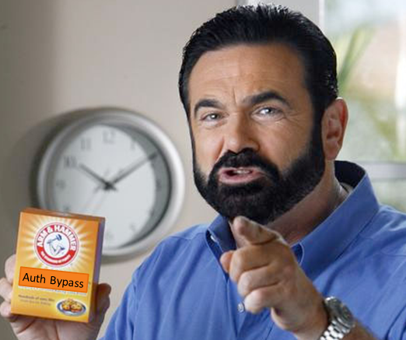
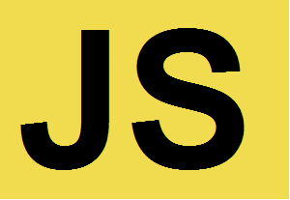
But wait! There's more!
But wait! There's more!
It also gets access to another special object ... .
All of them get *exactly* the same object.
This thing has a name ...
The "prototype"
Notes:
The new object has a constructor Function that has a prototype which is an object.

Slide 201
prototype
/ˈprōdəˌtīp/
noun
the original or model on which something is based or formed.
someone or something that serves to illustrate the typical qualities of a class; model; exemplar. ie: She is the prototype of a student activist.
something analogous to another thing of a later period. ie: a Renaissance prototype of our modern public housing.
Biology. an archetype; a primitive form regarded as the basis of a group.
From Random House Dictionary via Dictionary.com
Notes:
My favorite definition is #2
- The other students don't have that capability so they'd go to the 'exemplar' to use hers.

Slide 202

The prototype serves as a 'backup' of sorts
If we try to access a property which doesn't exist on the object itself,
JavaScript looks in its constructor's prototype for that property.
If it is present, that property is reported
If not, the prototype's prototype is searched
... and so on and so on and so on
... until JavaScript reaches the top of the chain
Then it reports that property as 'undefined'
Notes:
With traditional inheritance, you're creating the property/method, but each one owns its own property
With prototypal inheritance, they all share the same one.
Some rules:
You cannot access object.prototype – Doesn't exist. object.__proto__ does, though

Slide 203

Prototypes are not inheritance
Inheritance
Prototype = an object that adds additional behavior
It is attaching behavior to all objects of that type even after they're created.
Prototypes allow us to add behavior to all objects of the same type
Can attach to JavaScript built-in constructors like Number, Array, String, Object.
Prototyping
Notes:
(You can, but be careful. It can cause problems).
What problems? See Ninja book pp 135-139.

Slide 204
The object's prototype is never checked.
Regular objects don't have a prototype, only Functions do.
The object's constructor's prototype is checked.
Thus you can add prototypes after instantiation and it is there.
Person.prototype
Person
p1
p6
p3
p5
p2
p4

Slide 205
The prototype on instances is read-only
Person does not have a firstname, but its prototype does.
Works – pulls from the prototype
var p = new Person();
console.log(p.firstname);
console.log(p.prototype.firstname);
p.firstname = "Joe";
p.prototype.firstname = "Joe";
p.__proto__.firstname = "Joe";
Does not work b/c objects don't have prototypes; Functions do
Works. Adds a firstname to p
Does not work. Can't set property 'firstname' of 'undefined'
Works, but really bad idea. Sets firstname for all instances. Breaks encapsulation
Notes:
object.__proto__ is only an EC2015 standard for backward compatibility. Use Object.getPrototypeOf() instead.

Slide 206
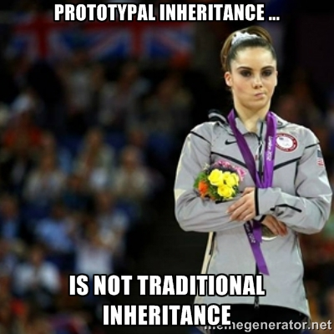
So you can see why this isn't exactly like traditional inheritance

Slide 207
Overriding

Slide 208

Overriding is easy
To override, simply set a value (property) or a function (method) in either the constructor or on the object itself after instantiation

Slide 209
Overridding is easy ...
Most SuperHeroes can fly.
function SuperHero(){ }
SuperHero.prototype.fly = function() {
// Most heroes can fly
};
function HumanSuperHero() { ... }
HumanSuperHero.prototype = new SuperHero();
var batman = new HumanSuperHero();
batman.fly();
// Human superheroes can't fly! Let's override
HumanSuperHero.prototype.fly = function () {
console.warn('This hero cannot fly');
};
batman.fly();
A HumanSuperHero is a SuperHero
Batman can fly?!? That's not right.
Better. Batman can't fly now.

Slide 210
Protected
Means if something inherits from this class, these variables are seen by the child objects, but nothing else.
Make it private then assign it as a prototype?

Slide 211
ES2015 Classes

Slide 212
ES2015 Added some new keywords
extends - Assigns a prototype
super - Refers to the prototype
Don't be tricked!
These don't add any new capabilities. They're only more direct ways of working with prototypes.

Slide 213
extends registers a prototype
class Employee extends Person {
constructor(first, last, salary) {
super(first, last);
this._salary = salary;
}
}
const e = new Employee("Chris","Lee",75000);
console.log(e.doStuff()); // Chris Lee doing stuff
Notes:
If subclass doesn't have a constructor defined, JS runtime will call the prototype's constructor on instantiation
If it does (even an empty one), it is called.
Weirdly, e gets its own copy of first and last. Not on the prototype. But doStuff() is indeed on the prototype. Best of both worlds.

Slide 214
super() - call the same method on the superclass
super.methodName() - call another method on the superclass

Slide 215
To be OO, we need certain things
Objects
Classes
Properties
Methods
Constructors
Encapsulation
Private members
Public members
Static members
Accessor functions
Overloading
Inheritance
Overriding
Interfaces
Namespaces
Notes:
JavaScript has NONE of these things but they can be faked

Slide 216
tl;dr
JavaScript doesn't handle traditional inheritance but it does have prototypal inheritance and that can be used to mimic it.
Overriding can be done simply by setting the value in the object itself; you get it for free.

Slide 217
Further Study
Two articles on importance of JavaScript
http://freshbrewedcode.com/jimcowart/2012/09/01/is-javascript-tragically-important-2/
http://www.simple-talk.com/opinion/opinion-pieces/a-sudden-move-one-developer%E2%80%99s-journey-from-c-to-javascript/?utm_source=simpletalk&utm_medium=email-main&utm_content=suddenmove-20121224&utm_campaign=opinion
Notes:
pp. 29-34

Slide 218
OO JavaScript – Design Patterns
Notes:
The Simpsons

Slide 219

A design pattern is …
… a battle-tested solution to a known design problem.
Allows for fast, reliable solutions.
Allows quicker, more precise __________.
Allows a higher level of __________.
Notes:
Quicker, more precise communication.
Higher level of thinking.

Slide 220

An example: Two carpenters making a drawer
How should they join the drawer sides?
Notes:
Miter joint: Very simple to make. Cut at 45 degrees and glue or nail together. Nearly invisible. Can’t be seen.
Dovetail: Very complicated to do well. Many precise cuts on both pieces of wood. Beautiful, though. Very, very strong. In fact, it gets stronger, the harder the pull on it.

Slide 221

Two solutions
Maybe we could make the joint by cutting straight down into the wood, and then cut back up 45 degrees, and then going straight back down, and then back up the other way 45 degrees, and then going straight back down, and then …
We could cut each at 45 degrees and nail or glue the facing pieces together.
Notes:
Seen both of these solutions before. Both work.

Slide 222
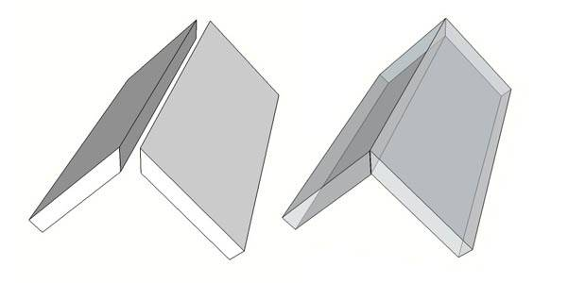
Miter Joint
Easy
Quick
Cheap
Invisible

Slide 223
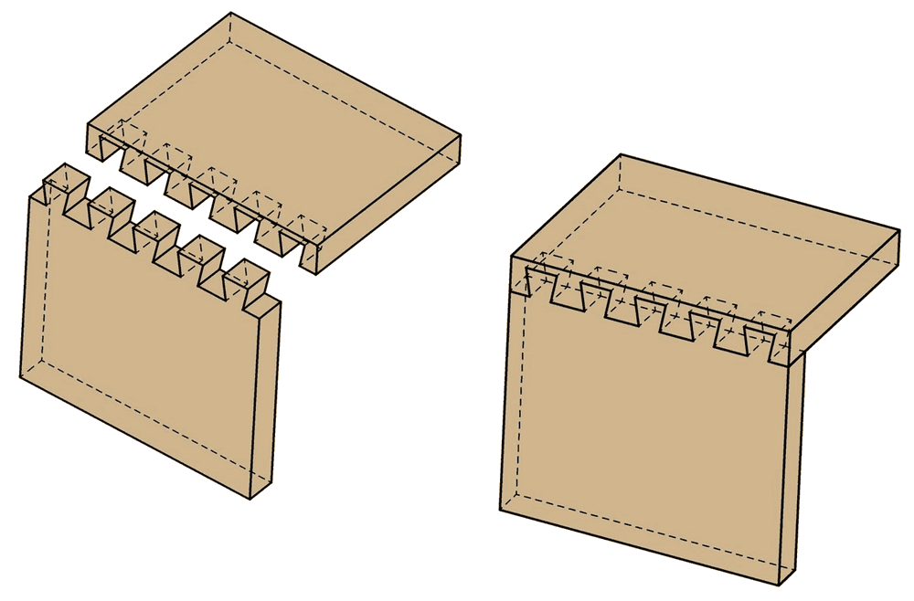
Dovetail joint
Very complicated!
Time consuming
Extremely strong
Requires no glue or nails
Looks beautiful
Notes:
So when we say dovetail vs. miter, we’re really saying
Time-consuming but long-lasting … or … It’ll break soon but I get home in time to see the game?
None of those were actually said, but the carpenters had a conversation at a higher level – a meta-level.
Review the advantages of design patterns:
Quick & reliable solution
Higher level of thinking
Better, more precise communication.

Slide 224
JavaScript Design Patterns
We'll cover several well-used JavaScript design patterns
Most are unique to the JavaScript community
Since JavaScript makes it so easy to pollute the global namespace and since libraries are so popular, the biggest deal in all of these patterns is ...
Encapsulation
Notes:
You wouldn't be expected to be able to repeat all of these on a test
Nor even understand them totally
But as you break these down, you start to get a feel for JavaScript patterns and will adapt these to your own use.

Slide 225
Immediately Invoked Function Expression

Slide 226

Immediately Invoked Function Expression (IIFE)
Guaranteed to run automatically and only once
A JavaScript black hole

Slide 227

Quiz: What do these do?
var x = foo;
Sets x equal to foo – even if foo is a function
foo();
Runs the foo function
So if you take a function and put parens after it, you're telling JavaScript to run that function

Slide 228

Quiz: What is this?
function () {
// Do stuff here
}
An anonymous function, of course
How about this?
(function () {
// Do stuff here
})
Same thing

Slide 229

The payoff! The iife
If you combine the anonymous function with parentheses, you have your iife:
(function () {
// do stuff here
})()
This says to define this function and then run it.

Slide 230
You can encapsulate some parts and expose others
(function () {
Car = function (make) {
this.make=make;
this.go = function () {
// Do stuff to make it 'go'
}
};
})();
var c = new Car('chevy');
c.go();
var p = new Car('porsche');
Notes:
FFT: Wait! How can Car be seen outside the iife? ("Car" doesn't have a "var" in front of it so it is global).
Note: iffes can also be written by removing the parens and adding a "+" in front:
+function () { Car = ... }()

Slide 231
The Factory Function Pattern

Slide 232

The Factory Function Pattern
Used to abstractly create an object rather than instantiating it with 'new'.
Great way to create an object in a controlled way.
Notes:
Commonly used
You'll see it in others' code so we should cover it.
Allows the construction of an object to be changed easily

Slide 233
Note the 'return'
var makePerson = function(name){
return {
name: name,
getName: function(){
return this.name;
};
};
var p1 = makePerson("Maggie");
var p2 = makePerson("Lisa");
console.log(p1.getName()); // prints Maggie

Slide 234
The class Pattern

Slide 235
Some of the benefits of this pattern are:
* It’s great for when you have many of an item and each needs its own state.
* It’s a familiar OOP pattern / workflow for many developers.
* It has a constructor function that’s immediately fired on instantiation.
But the drawbacks are:
* You have to remember to instantiate before you can use it. If you don’t, it will cause errors.
* You have to keep a handle to the instance that’s returned from the constructor.
Notes:
I'm not sure this is a thing. It is just writing JavaScript to look like a class.

Slide 236
window.NR = window.NR || {};
window.NR.MyClass = (function () {
var MyClass = function(val) {
this.instanceVar = MyClass.staticVar + val;
};
MyClass.staticVar = "prefix-";
var instanceVar = "";
MyClass.prototype.exampleFunction = function () {
alert('i am an additional function');
};
return MyClass;
}());
Notes:
We define a 'class' function inside an iffe.
Then we add on properties and methods.
Finally we return that function
It can now be run using 'new'

Slide 237
Run it like this ...
var instance1 = new NR.MyClass('class 1');
console.log(instance1.instanceVar);
NR.MyClass.staticVar = 'PREFIX-';
var instance2 = new NR.MyClass('class 2');
console.log(instance2.instanceVar);
// Outputs
// "prefix-class 1"
// "PREFIX-class 2"

Slide 238
The Prototype Pattern

Slide 239

The prototype pattern
Don't get too excited. This is simply saving memory and controlling behavior by sharing properties via the prototype.
Notes:
You just identify all the properties that are common to all instances and move them to the prototype.
When there's just one copy, it saves on memory.

Slide 240
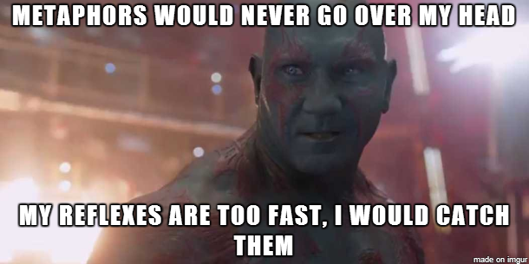

Two forms ...
Object literal
Constructed

Slide 241
Object literal format
If Person is the constructor function ...
Person.prototype = {
doSomething: function () {
console.log('do something');
},
doSomethingElse: function () {
console.log('do something else');
}
};

Slide 242
Constructed format
// build our blueprint object
var MyBluePrint = function MyBluePrintObject() {
this.someFunction = function someFunction() {
alert( 'some function' );
};
this.someOtherFunction = function someOtherFunction() {
alert( 'some other function' );
};
this.showMyName = function showMyName() {
alert( this.name );
};
};
function MyObject() {
this.name = 'testing';
}
MyObject.prototype = new MyBluePrint();

Slide 243
The Revealing Object Pattern

Slide 244

The Revealing Object Pattern
An easy to understand pattern that provides encapsulation
Provides a controlled object without using 'new'
Notes:
coined by Crockford

Slide 245
The revealing object pattern
var createWorker = function () {
var workCount=0; //A private variable
var t1 = function () {
workCount++;
console.log("task1 " + workCount);
};
var t2 = function () { ... } //Same as t1
return {
doWork1: t1,
doWork2: t2
};
};
var worker = createWorker();
worker.doWork1();
worker.doWork2();
Notes:
//Note that createWorker and t1 are now closures b/c of workCount.

Slide 246
The module pattern
Notes:
Note: this and the revelaing object pattern should be moved BEFORE the prototype pattern. Always keep the module pattern after the revealing object pattern.

Slide 247
A variation of the revealing object pattern
Simply self-executes so you don't have to remember to.

Slide 248
The module pattern
var worker = function () {
var workCount=0; //A private variable
var t1 = function () {
workCount++;
console.log("task1 " + workCount);
};
var t2 = function () { ... } //Same as t1
return {
doWork1: t1,
doWork2: t2
};
}();
//var worker = createWorker(); <-- Eliminated!
worker.doWork1();
worker.doWork2();
Notes:
//Note that createWorker and t1 are now closures b/c of workCount.

Slide 249
The Self-attaching Object Pattern

Slide 250
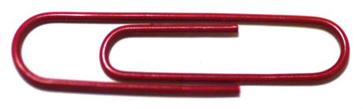
The Self-attaching Object Pattern
Whenever you have an object that needs to be attached to a namespace
Allows you to keep the attaching completely modular and complete encapsulated.
Notes:
Merely an IIFE with a passed-in namespace

Slide 251
Pass in the namespace
(function (ns) {
var bar = {
p1: someValue,
f1: function() { ... }
}
ns.foo = bar;
})(duff.products.ales);
... then later ...
var x = duff.products.ales.foo.p1;
duff.products.ales.foo.f1();

Slide 252
The Middleware pattern

Slide 253
The middleware pattern
Used often on server-side with NodeJS modules
Allows you to insert a function in a processing pipeline and specify what happens after your function
Your user will pass in the "next" function -- the thing he/she wants to run next.
That next function could be more middleware.
Software written with the intent of running as part of a bigger process and allowing a user to call something (usually asynchronously) after it is finished.

Slide 254
The middleware pattern
var express = require("express");
var router = new express.Router();
// use the api that provides a "next" callback
router.get("/", function(req, res, next){
// do some work, then call the next
next();
});

Slide 255
tl;dr
We looked at some very common patterns unique to JavaScript
They help us to overcome the limitations of this non-object-oriented language

Slide 256
Further Study
Large listing of more JavaScript design patterns
http://bit.ly/SimplifiedJSPatterns/
Free e-Book from O'Reilly
http://bit.ly/JavaScriptDesignPatternsEBook
Understanding GOF patterns in JavaScript
http://bit.ly/UnderstandingDesignPatternsInJavaScript

